Slide 1
PRINCIPLES OF ECONOMICS
Salimah Musharrif
FPEC 101 – LECTURE 14 Unit 2

Slide 2
PRINCIPLES OF ECONOMICS
Production Costs and Market Structures
FPEC 101 – LECTURE 14 Unit 2

Slide 3
Income inequality, poverty and discrimination

Slide 4
Outline
Facts about Income Inequality
Causes of Income Inequality
Trends of Income Inequality
Poverty
Discrimination

Slide 5
Income Inequality
Income distribution is more important a study to find out about income inequalities
Distribution by Income - measure income inequality by looking at the percentages of households in a series of income categories
Distribution by Quintiles (Fifths) - measure income inequality by dividing the total number of individuals, households, or families into five numerically equal groups, or quintiles, and examine the percentage of total personal (before-tax) income received by each quintile
Example, lowest 20%, second 20%, third, fourth and highest 20%
Lowest income household to the household with the highest income

Slide 6
The Lorenz Curve & Gini Ratio
  The quintile distribution of personal income is presented through a Lorenz curve
  Plot the cumulative percentage of households on the horizontal axis and the percentage of income they obtain on the vertical axis.
  Diagonal line 0e represents a perfectly equal distribution of income because each point along that line indicates that a particular percentage of households receive the same percentage of income. In other words, points representing 20 percent of all households receiving 20 percent of total income, 40 percent receiving 40 percent, 60 percent receiving 60 percent, and so on, all lie on the diagonal line.
  Lorenz curve shows actual distribution of income
  The area between the diagonal (the line of perfect equality of income distribution) and the Lorenz Curve shows inequality in the distribution of total income.
  Inequality is measured numerically by the Gini ratio—area A (shown in brown) divided by area A + B (the brown +green area).

Slide 7
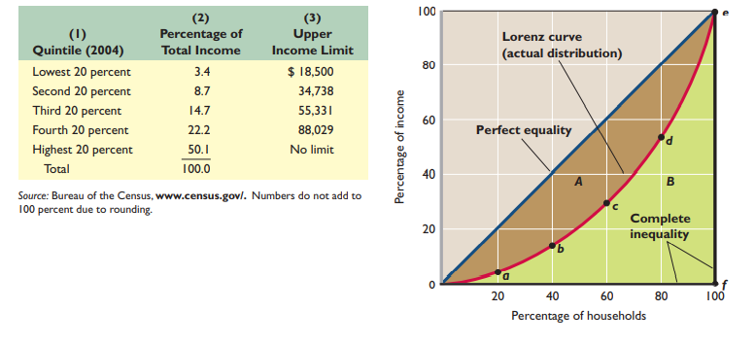
The Lorenz Curve & Gini Ratio
We plot the quintile data
Get Lorenz curve
a-Bottom 20 % of households
received 3.4 % of the income
b-bottom 40 % received 12.1 % ( 3.4 +8.7) so on
Brown area- degree of income inequality
If perfect equality, in income distribution,
Lorenz curve and the diagonal would coincide and the brown area would disappear.
Mc Connell & Brue

Slide 8
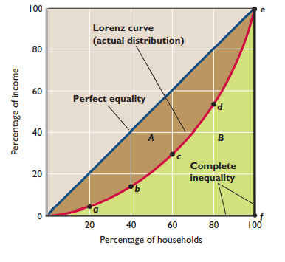
The Lorenz Curve & Gini Ratio
At the opposite extreme is complete inequality, where all households but one have zero income.
Lorenz curve would coincide with the horizontal axis from 0 to point f (at 0 % of income)
and then move immediately up from f to point e
along the vertical axis (indicating that a single
household has 100 % of the total income)
Area below the diagonal line (triangle 0ef )
would indicate this extreme degree of inequality.
Farther Lorenz curve sags away from the diagonal, the greater the degree of income inequality.
Mc Connell & Brue

Slide 9
The Lorenz Curve & Gini Ratio
The income inequality described by the Lorenz curve can be transformed into a Gini ratio
Gini ratio =
Area between Lorenz curve and diagonal
Total area below the diagonal
= A (brown area)
A + B (brown + green area)
Lower Gini ratios denote less inequality
Higher ratios indicate more inequality.
Gini coefficient for complete income equality is 0
Gini coefficient for complete inequality is 1
Mc Connell & Brue

Slide 10
Income mobility
Income mobility or “churning around” in the distribution of income over time means movement of individuals or households from one income quintile to another over the period of their lives
Short time periods , say a year, may mean reflection of an unequal income distribution although with time, perhaps, it may get more or completely equal.
“ Low income’’ and “high income” are not permanent conditions.
People move into different income quintiles with age, experience etc.
The longer the time period considered, the more equal the distribution of income becomes.

Slide 11
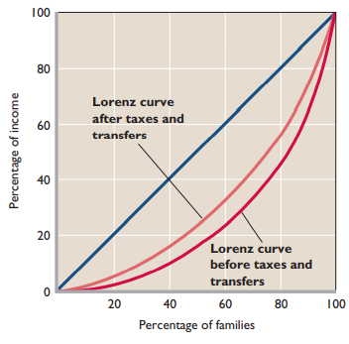
Effect of Government Redistribution
Government redistributes income from higher- to lower-income households through taxes and transfers.
Personal income pre tax covers wages, salaries, dividends, interest income, cash transfer payments such as Social Security, unemployment compensation benefits, and welfare assistance to needy families.
It excludes the effects of personal income and payroll (Social Security) taxes that are levied directly on income receivers, noncash transfers ,which provide specific goods or services rather than cash such as medical benefits, housing subsidies, subsidized school lunches, and food stamps etc. These are like income because they enable recipients to in effect “purchase” goods and services.
After redistribution, more equal income distribution

Slide 12
Causes of Income Inequality
  Ability
  Education and Training
  Discrimination
  Preferences and Risks
  Unequal Distribution of Wealth
  Market Power
  Luck, Connections, and Misfortune

Slide 13
Trends of Income Inequality
In absolute dollar amounts, the entire distribution of income increased
The relative distribution of income, though, may become less equal, more equal, or remain unchanged. It has become more uneven.
Absolute income of both the rich and the poor are experiencing rise, however, while incomes have risen in all quintiles, income growth has been fastest in the top quintile
Causes
  Greater Demand for Highly Skilled Workers
  Demographic Changes
  International Trade, Immigration, and Decline in Unionism

Slide 14
Poverty
Poverty is a condition in which a person or a family does not have the means to satisfy basic needs for food, clothing, shelter, and transportation. The means include currently earned income, transfer payments, past savings, and property owned. The basic needs have many determinants, including family size and the health and age of its members
poverty rate—the percentage of the population living in poverty
Incidence of poverty more prevalent in some groups than others
Mostly world over poverty on the rise
Measurement issues- income or consumption?
Income Maintenance System ( Entitlement programs)- social insurance , public assistance, or “welfare.”
Welfare Goals:
  Effective in getting individuals and families out of poverty.
  Provide adequate incentives for able-bodied, nonretired people to work.
  Its cost should be “reasonable.”
Reforms – time based, conditions changed etc

Slide 15
Discrimination
When people with similar economic characteristics experience different economic outcomes because of their race, sex, or other noneconomic characteristics
Types
  Wage – less pay
  Occupation- prohibited from entering the more desirable, higher paying occupation
  Employment-inferior treatment in hiring, promotions, assignments, temporary layoffs, and permanent discharges, workplace harassment
  Human capital discrimination occurs when women or members of minorities do not have the same access to productivity-enhancing investments in education and training as white males

Slide 16
Discrimination
Costs
Discriminator gets good job at cost of others
Reduces economy’s output and income acting as an artificial barrier to free competition, decreasing economic efficiency and reducing production as qualified groups of people are prevented from entering high-productivity (and thus high-wage) jobs
Decreases efficiency of economy moving point to further inside the PPC curve

Slide 17
Discrimination
Anti discrimination policies
To promote a strong, growing economy so that more workers are needed and more efficient recruitment would take place, eliminating discrimination
Improve the education and training opportunities of women and minorities
Direct intervention - outlawed certain practices in hiring, promotion, and compensation
Views
+ provide more training and education to close this gap
+ drastic measures needed as discrimination has been long embedded
+ endorse preferential treatment
- reverse discrimination

Slide 18
SUMMARY
Facts about Income Inequality
  Income distribution by income category
  Income distribution by quintiles
  The Lorenz Curve & Gini Ratio
  Income mobility
  Effect of Government Redistribution
Causes of Income Inequality
  Ability
  Education and Training
  Discrimination
  Preferences and Risks
  Unequal Distribution of Wealth
  Market Power
  Luck, Connections, and Misfortune
Trends of Income Inequality

Slide 19
SUMMARY
Poverty
  Incidence
  Trends
  Measurement issues
  Income Maintenance System
Discrimination
  Types
  Costs
  Prevention policies
  Views

